Slide 1
COVID-19 TESTING MANAGEMENT SYSTEM
Team Members:
1. Kunal Desai
2. Vineet Totare
3. Yash Kale

Slide 2
Agenda
1. Aim
2. Abstract
3. Introduction
4. Software Requirements
5. Hardware Requirements
6. Assumptions and Dependencies
7. Conclusion

Slide 3
Aim
Software Testing and Quality Assurance Mini Project Dynamic website of covid-19 information using HTML,CSS,JAVASCRIPT And PHP,MYSQL database used to store user account, comment, and registration form detail ,RegularExpression testcases for testing purpose.

Slide 4
Abstract
Nowdays, Covid-19 TMS is one of the essential technique that are worldwide used in testing labs. It is mostly used for Covid-19 related issues in laboratory. In this project we tried to develop online and web based applications of Covid-19 TMS.
Our main focus is to minimize the crowd in area, because main reason of Covid19 spreading in large amount is people crowd in area.
We develop online system for Covid-19 management that brings up various COVID-19 test working online. Using this system we take Covid test through online platform. This system is very essential because first all of you not come to goes hospital for covid testing. Covid-19 TMS lab boy simply comes to home after register on portal at slotted time and collect sample from them.

Slide 5
Software Requirements
Software Component | Details
Output Software | Google chrome
Designing Languages | CSS
Designing Framework | BOOTSTRAP
Back end tool | MySQL
Server Side Language | PHP 5.5

Slide 6
Hardware Requirements
Hardware Component | Details
Processor | i5 10th gen , 2.4 GHz
Hard Disk | 1 TB HDD
RAM | 8 GB
Network Connection | WIFI

Slide 7
Introduction
Software Testing :
Testing is the process of evaluating a system or its components to find whether it satisfies the specified requirements or not.
Test Cases :
A Test Case is a set of actions executed to verify a particular feature or functionality of your software application. A Test Case contains test steps, test data, precondition, postcondition developed for specific test scenario to verify any requirement.
Regular Expression testcases :
A regular expression testcase is a pattern that is used to match in input text. A pattern consists of one or more character literals, operators, or constructs.

Slide 8
Covid-19 TMS is online based platform technology which is used for covid-19 testing. For testing first user or patient register on Covid-19 TMS portal provide personal test information. After registered on portal patient can see many variety of test conducted by labs. After registration patient will select the required test and book appointment as per consultation. After successful sample collection patient can track their history using registered mobile number or email id. The system can show the report on user side so user can download report easily. In COVID19 Testing Management System we use PHP and MySQL database.

Slide 9
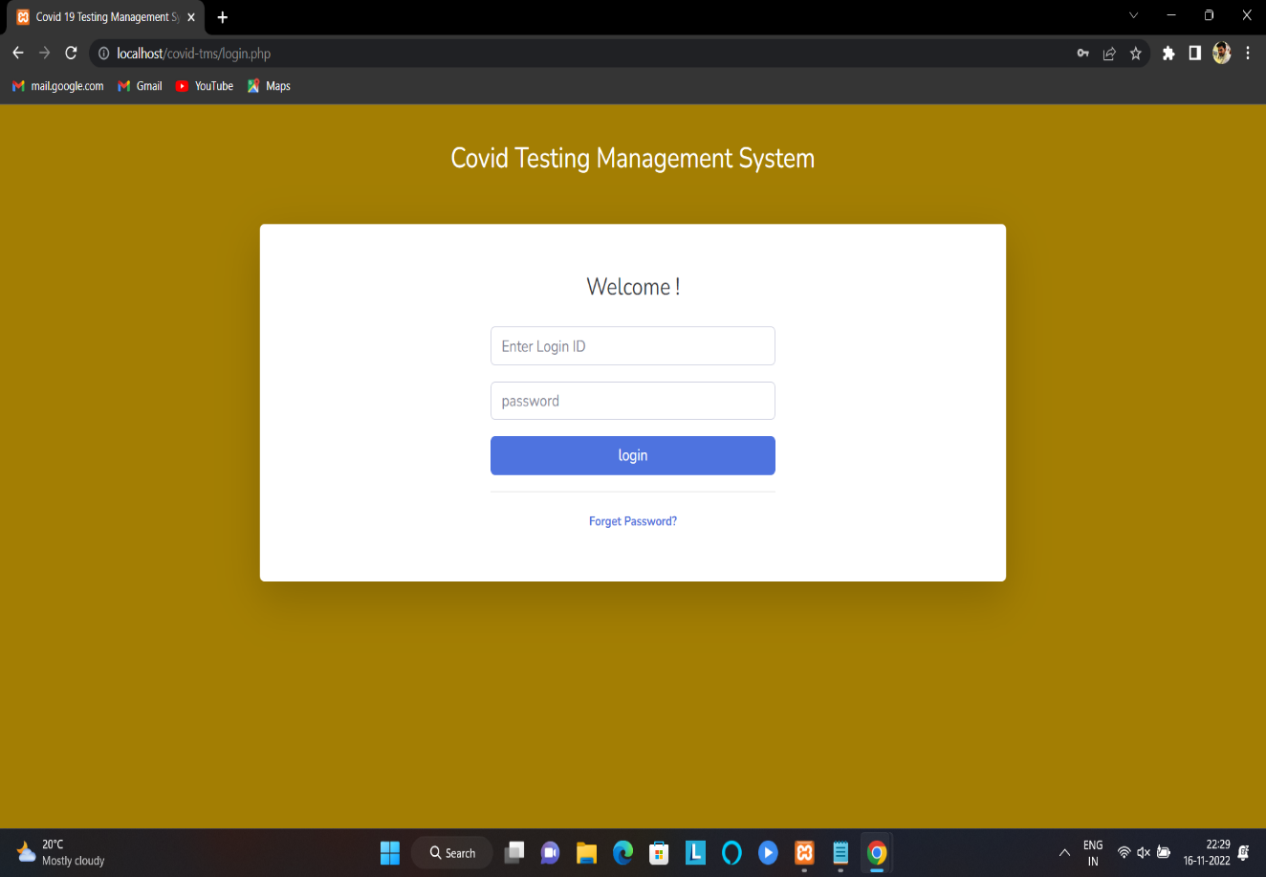
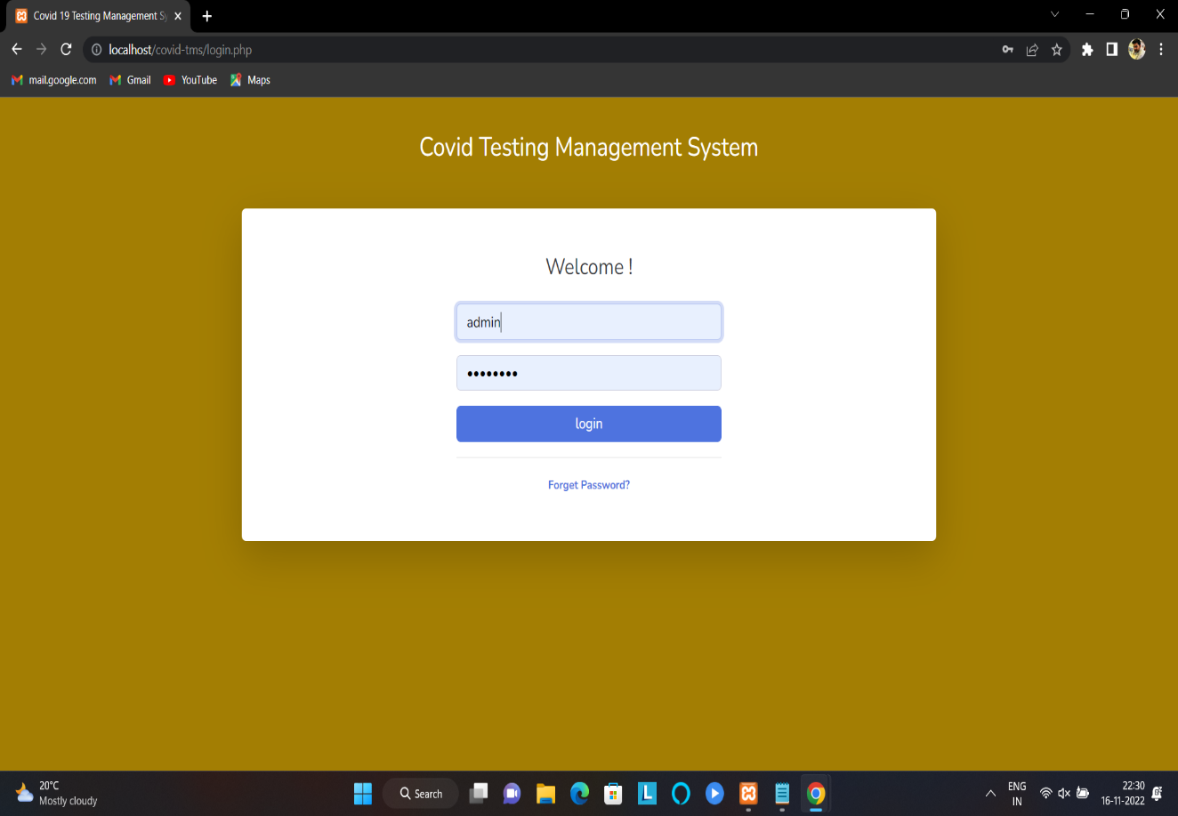
Login

Slide 10
It includes two types of modules.
Admin Module:
Admin is the super-user of the website who can manage everything on the website. Admin can log in through the login page.
2. Patients Module:
User can visit the application through a URL.

Slide 11
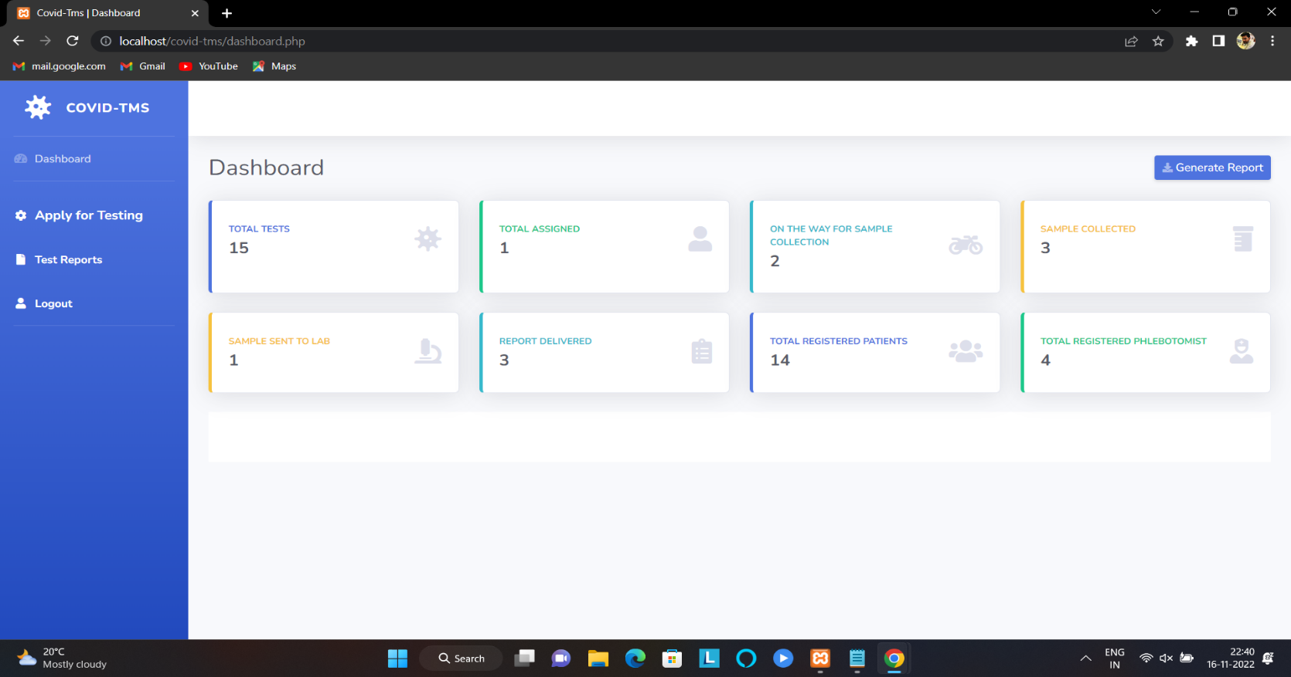
Admin Module:
Dashboard: In this section, the admin can see all detail in brief like the total, assigned and the sample collected and completed tests.

Slide 12
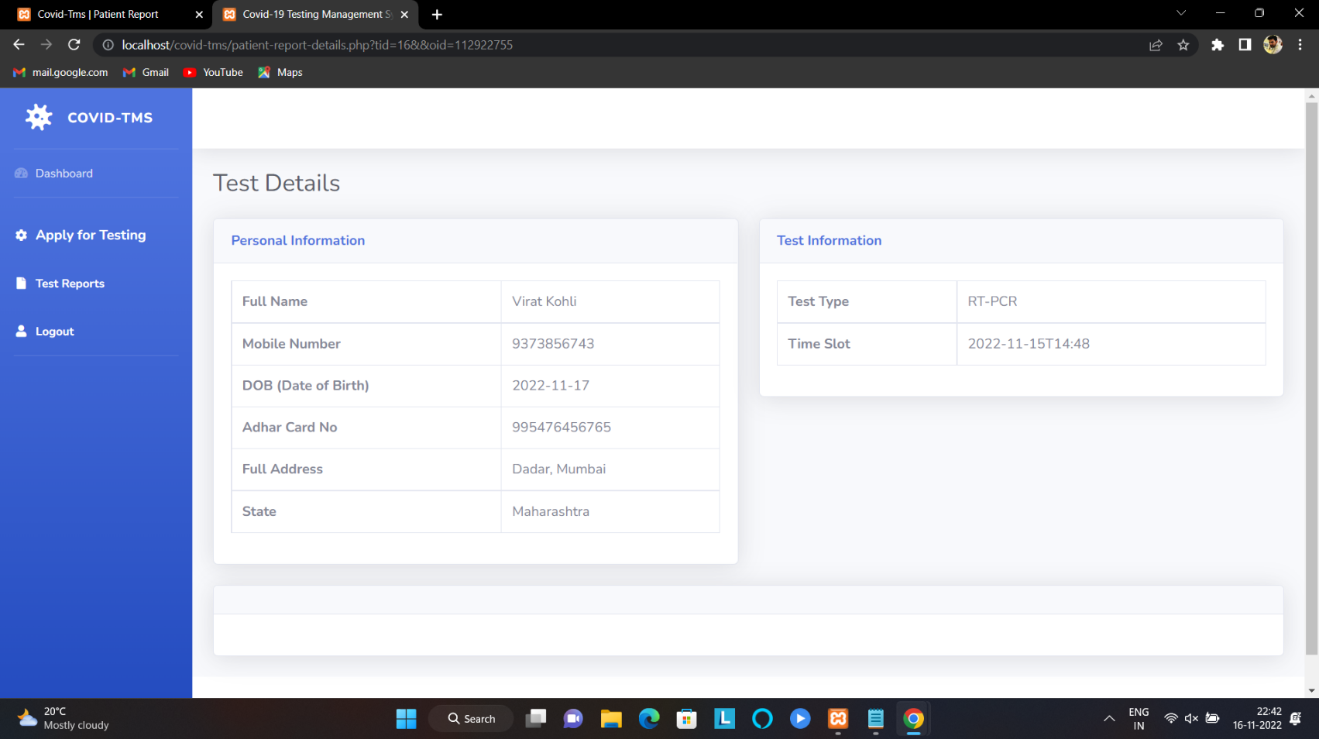
Testing: In this section, the admin can manage all the tests and update the history. Also we can view details in view section.

Slide 13
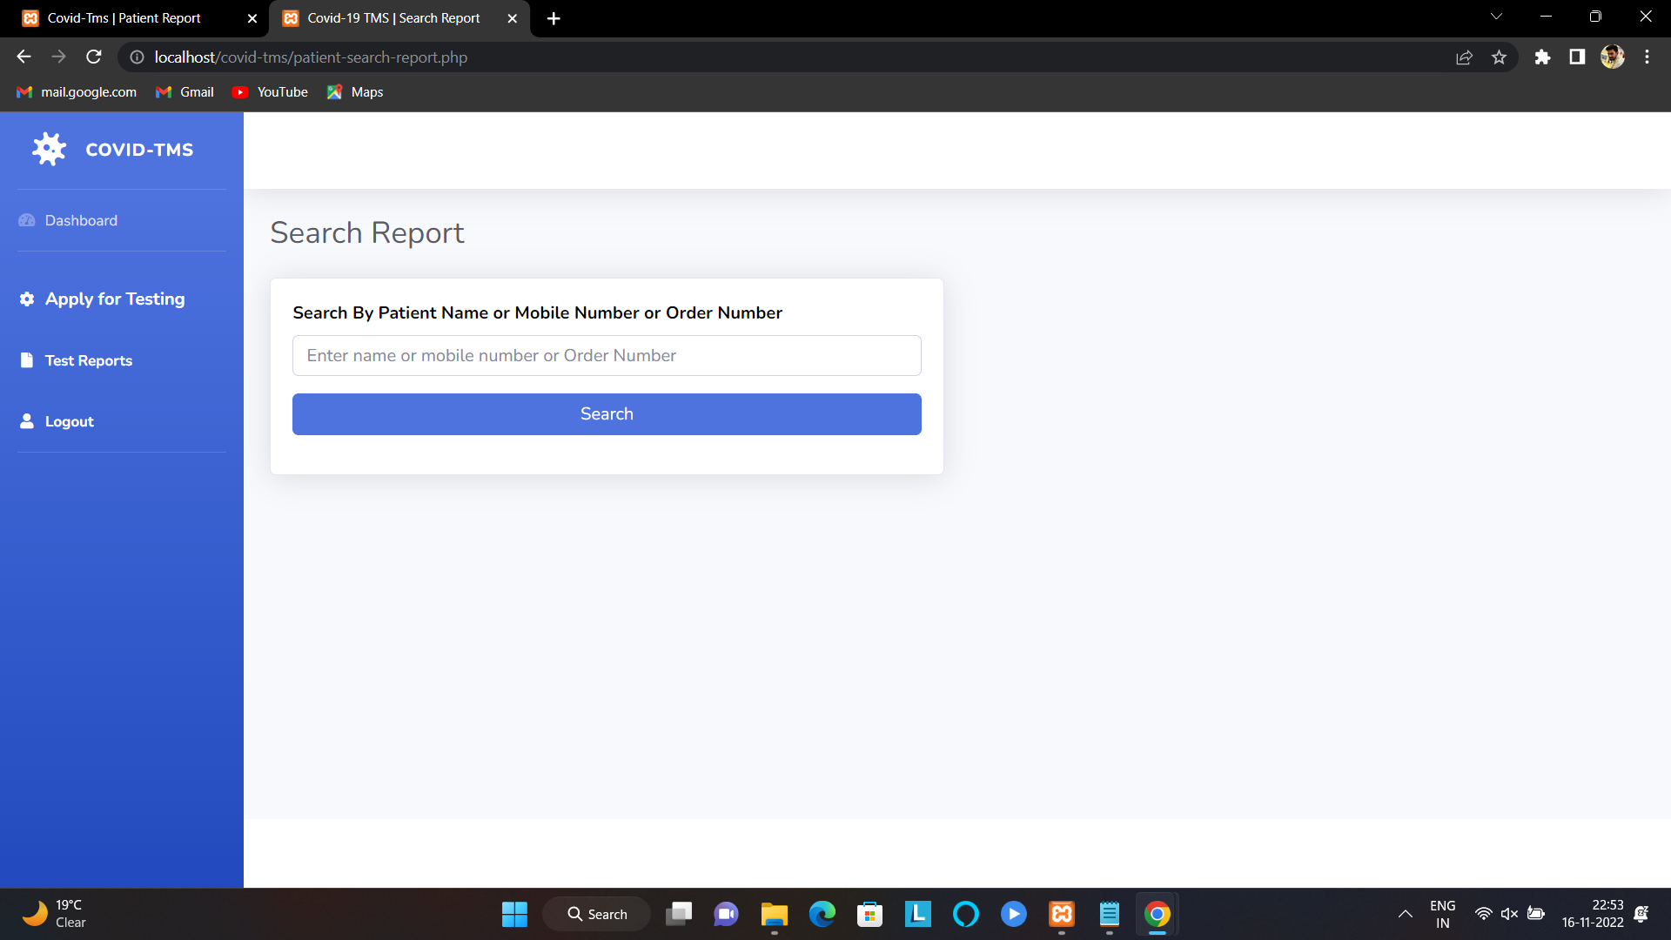
Report: In this section, the admin can generate report.
By search using order number, name and mobile number

Slide 14
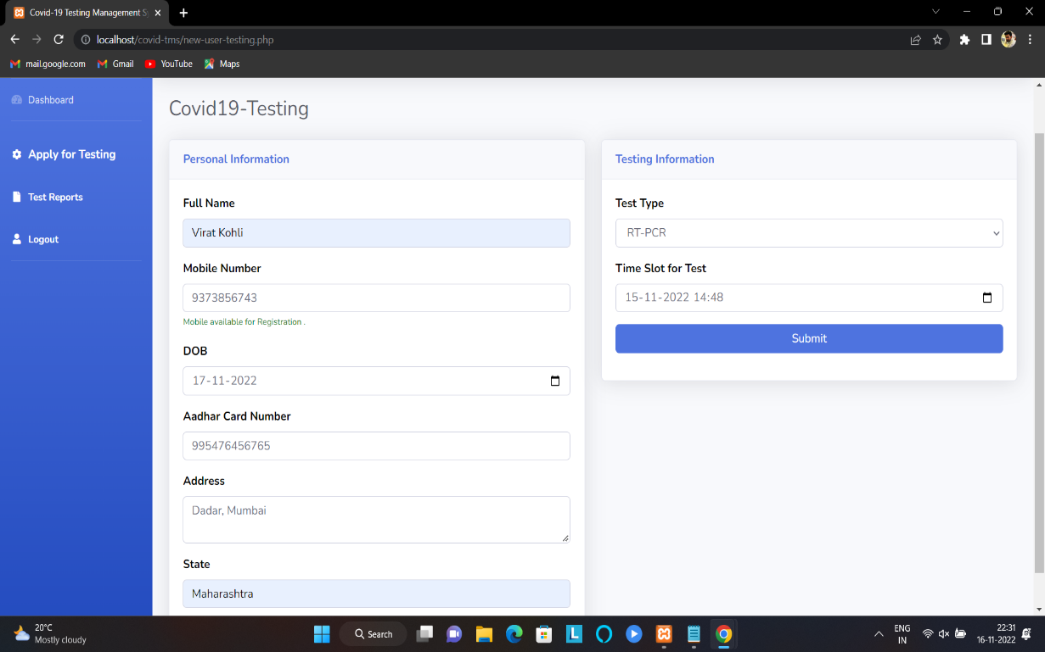
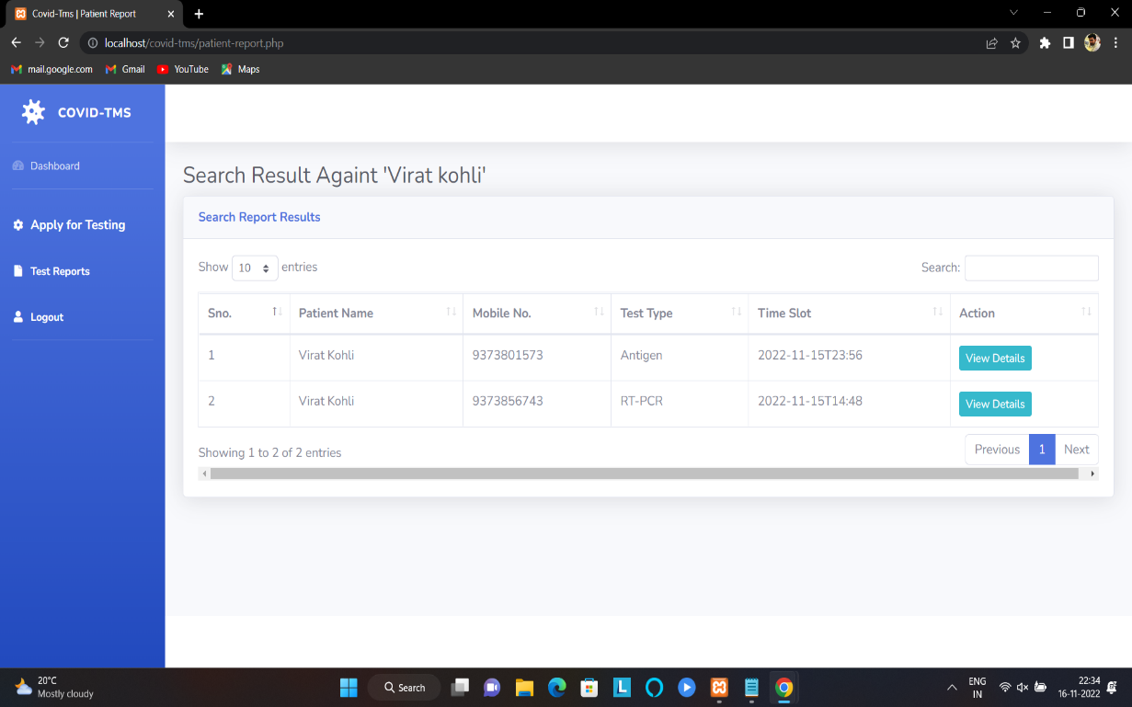
2. Patients module:
Testing: This section divided into two parts. One is for new user and another one is for registered user. New user (First-time user) needs to provide personal and testing Information. A registered user only needs to provide test information, their personal information will be fetched from the database.

Slide 15

Report: In this section, Users can search their test report using order number, name and registered mobile number.

Slide 16
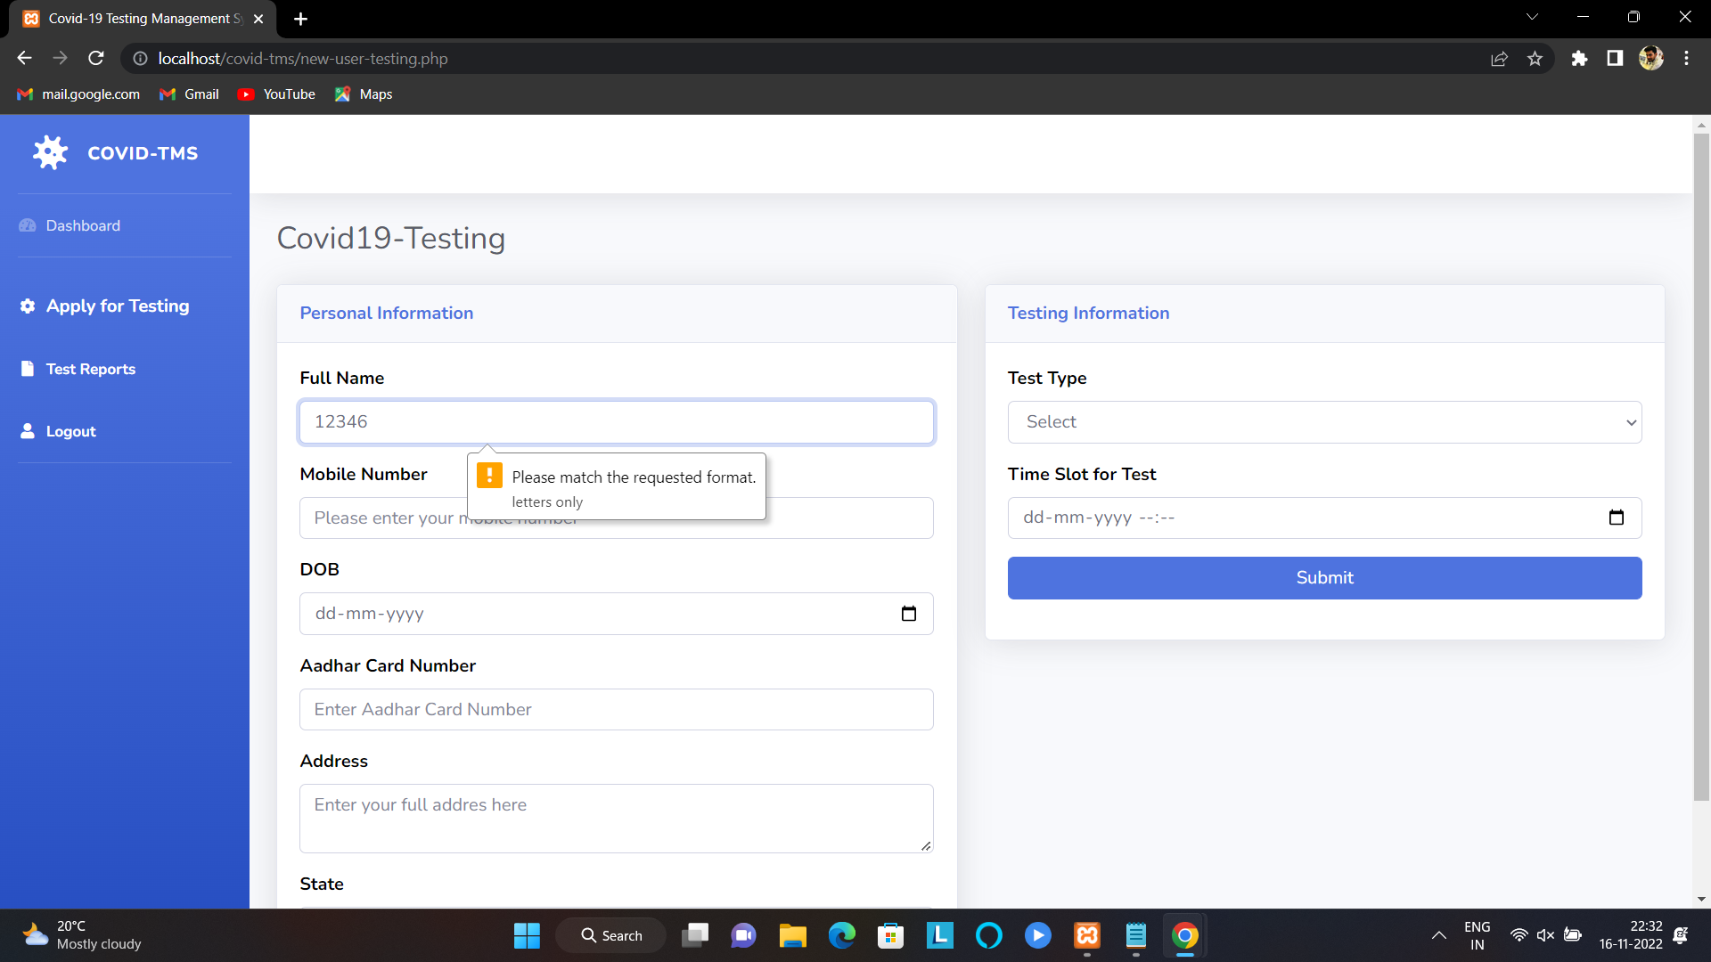
Testing
Full Name Regular Expression : [A-Za-z ]+

Slide 17

Mobile Number Regular Expression : [0-9]{10}

Slide 18
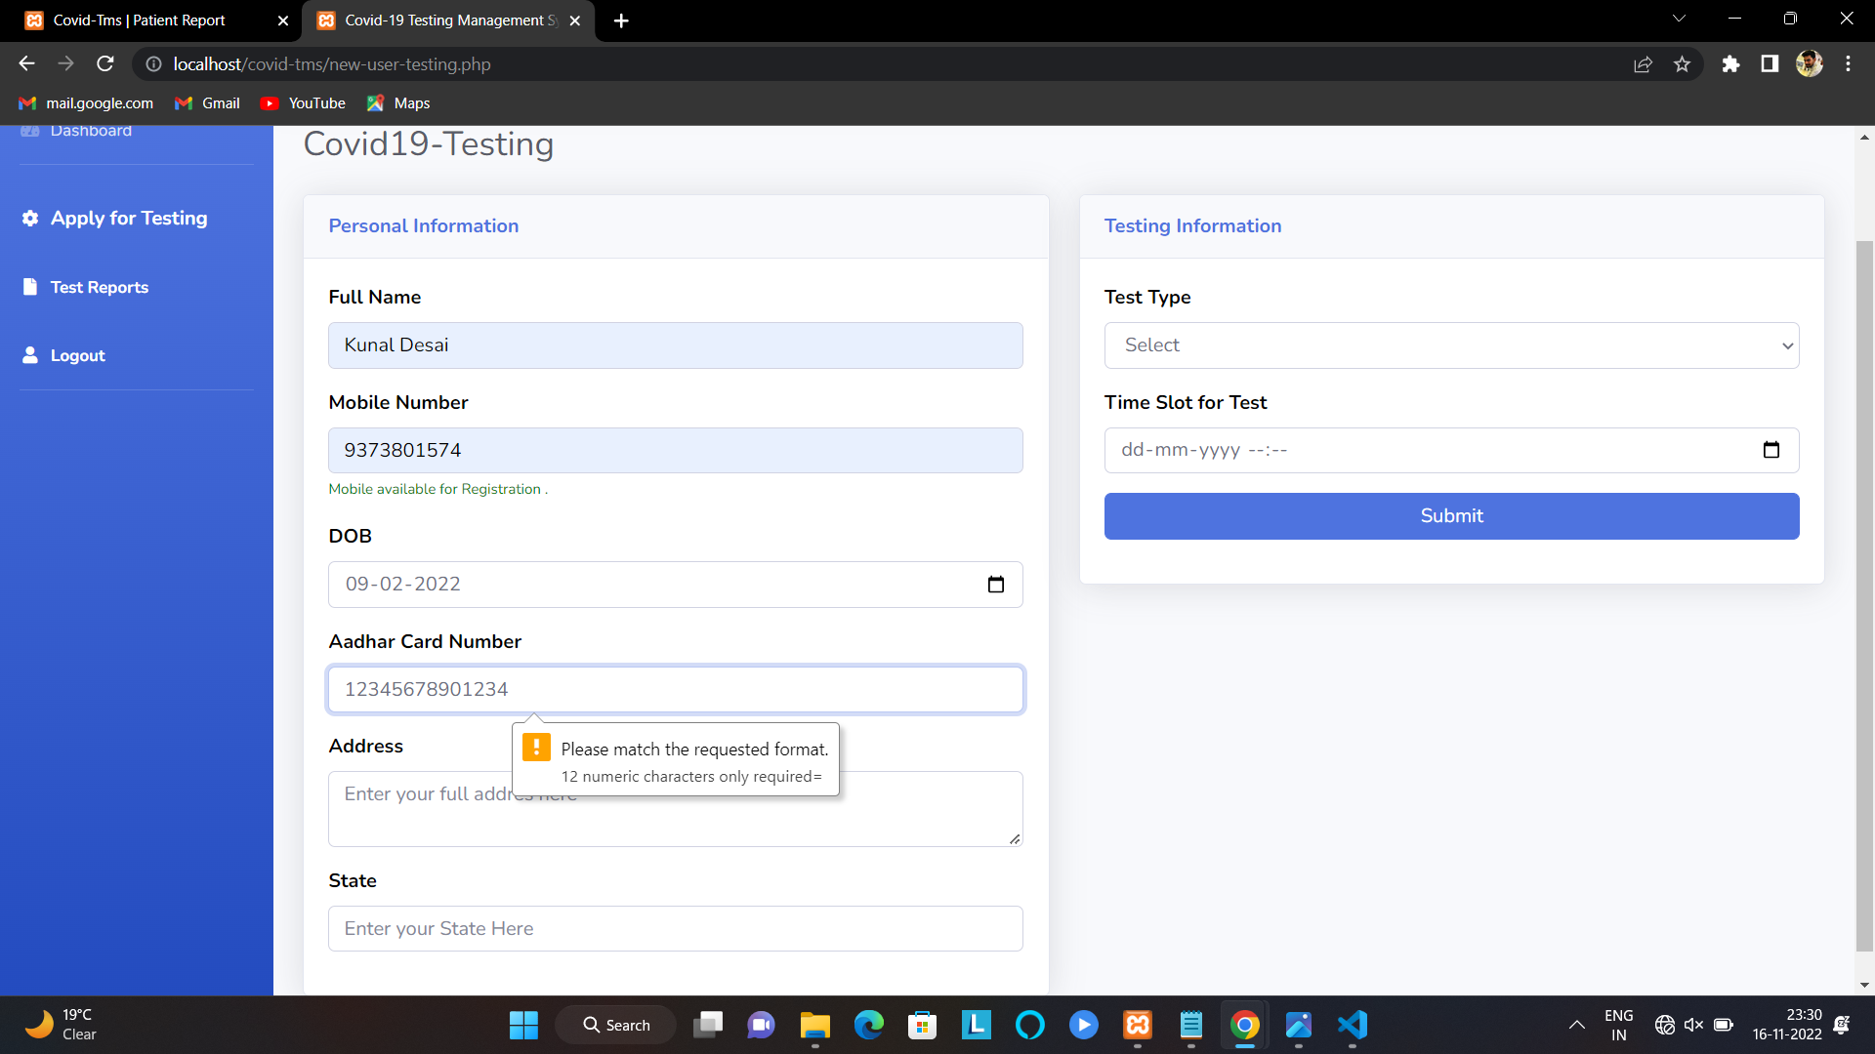
Aadhar Card Number Regular Expression : [0-9]{12}

Slide 19
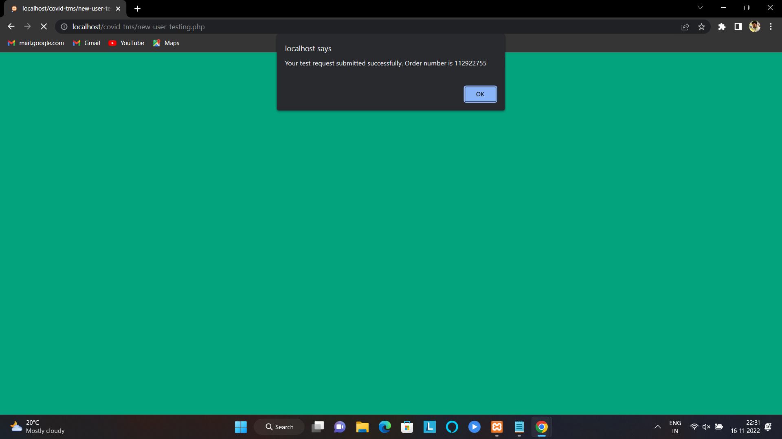
Submitting Form

Slide 20
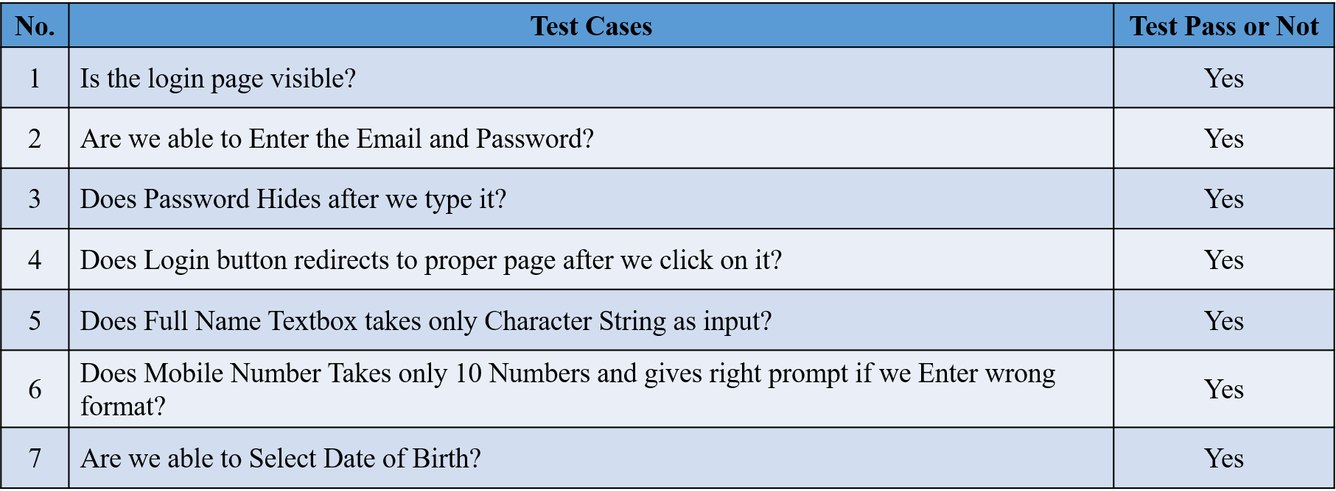
Use Case Test Cases :

Slide 21
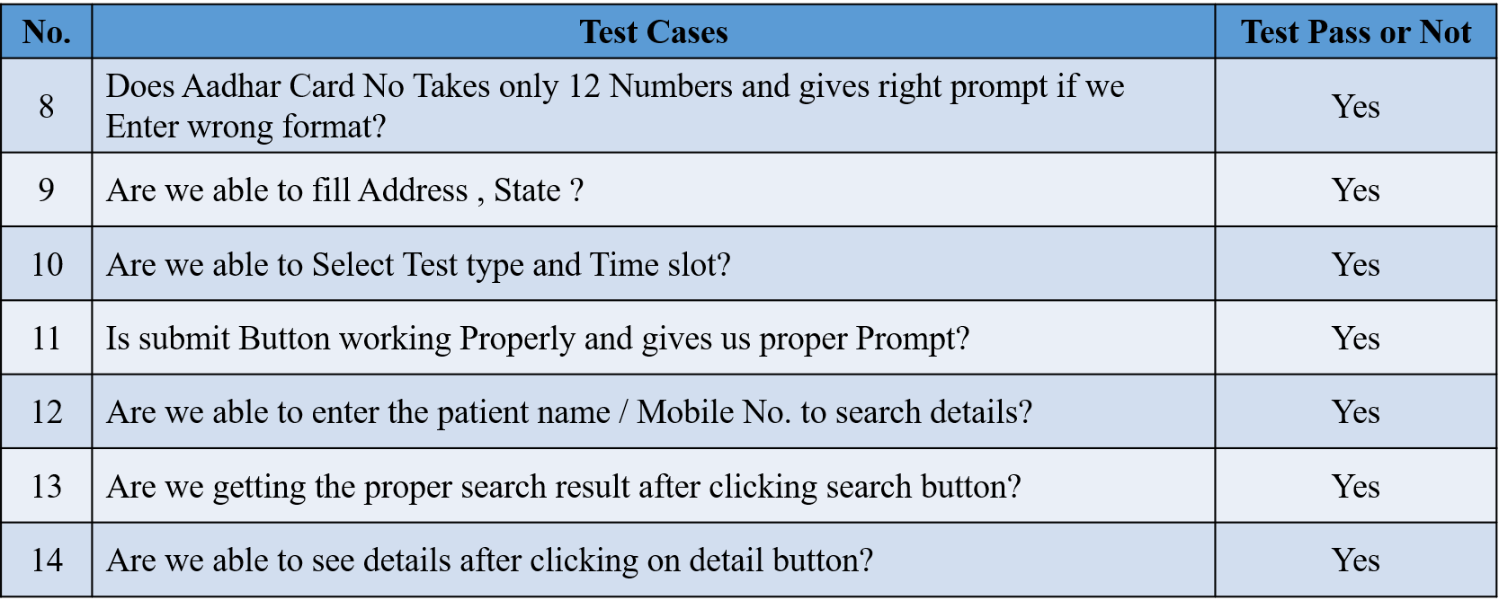

Slide 22
Assumption & Dependencies
The functioning of the application relies on MySQL being available on the host machine.
It is also dependent on a web browser to access the application.
The product is assumed to be developed for demonstrative purposes and hence internet connectivity is not include.

Slide 23
Conclusion
Thus , We were able to create a dynamic website of Covid-19 information and were also able to test it using Regular Expression as well as Use case Test Cases .

